Slide 1
Technician License Course Chapter 4
Lesson Plan Module 8 – Propagation

Slide 2
Radio Wave Propagation: Getting from Point A to Point B
Radio waves propagate in many ways depending on…
Frequency of the wave
Characteristics of the environment
We will discuss three basic ways:
Line of sight
Ground wave
Sky wave

Slide 3
Line-of-Sight
Radio energy can travel in a straight line from a transmitting antenna to a receiving antenna – called the direct path
There is some attenuation of the signal as the radio wave travels due to spreading out
This is the primary propagation mode for VHF and UHF signals.
Notes:
Line-of-sight is probably the easiest propagation mode for students to understand. You can use a laser pointer to demonstrate line-of-sight. You will probably have to refresh the students memory on UHF and VHF definitions and their position on the RF spectrum. Also these bands will be the primary operating bands of the new hams.
The maximum distance for line-of-sight transmissions with two people standing on the surface of the earth is about (roughly) 25 miles, this is due to the curvature of the earth. You can extend this discussion by briefly brining up repeaters and how they extend the line-of-sight range.

Slide 4
Ground Wave
At lower HF frequencies radio waves can follow the Earth’s surface as they travel.
These waves will travel beyond the range of line-of-sight.
Range of a few hundred miles on bands used by amateurs.
Notes:
Point out that this propagation mode is the one used by AM broadcast stations in the day light hours. You can connect with the students experiences with receiving AM broadcast stations using ground waves that fade with distance during the day.

Slide 5
Reflect, Refract, Diffract
Radio waves are reflected by any conductive surface
Ground, water, buildings
Refraction or bending occurs when waves encounter a medium having a different speed of light, such as water or an electrical feed line.
Notes:
Good time for a demonstration of reflection, refraction, and diffraction using a laser pointer.

Slide 6
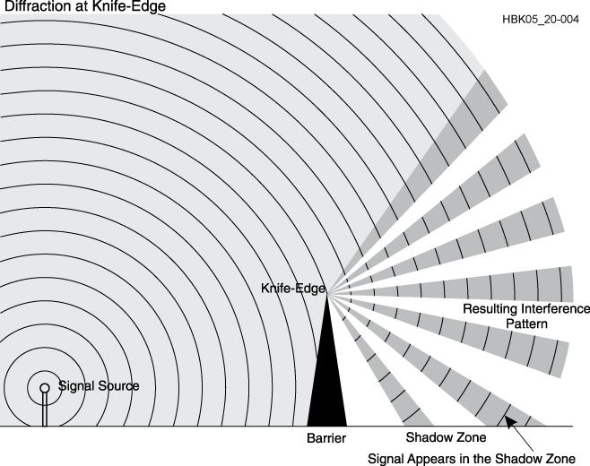
Reflect, Refract, Diffract
Diffraction occurs when a wave encounters a sharp edge (knife-edge propagation) or corner

Slide 7
VHF and UHF Propagation
Range is slightly better than visual line of sight due to gradual refraction (bending), creating the radio horizon.
UHF signals penetrate buildings better than HF/VHF because of the shorter wavelength.
Buildings may block line of sight, but reflected and diffracted waves can get around obstructions.
Multi-path results from reflected signals arriving at the receiver by different paths and interfering with each other.
Picket-fencing is the rapid fluttering sound of multi-path from a moving transmitter
Notes:
The maximum distance for line-of-sight transmissions with two people standing on the surface of the earth is about (roughly) 25 miles, this is due to the curvature of the earth. The radio horizon is about 10 percent farther due to gradual bending of the waves in the atmosphere.

Slide 8
“Tropo” - Tropospheric Propagation
The troposphere is the lower levels of the atmosphere – to about 30 miles high
Radio waves can be reflected or scattered by clouds, rain, and density variations in the troposphere – range up to about 300 miles
Temperature inversions and weather fronts can form ducts that trap and conduct VHF and UHF radio waves for hundreds of miles
Notes:
Note that tropospheric propagation allows TV and FM signals to sometimes be receiver far beyond their normal range.

Slide 9
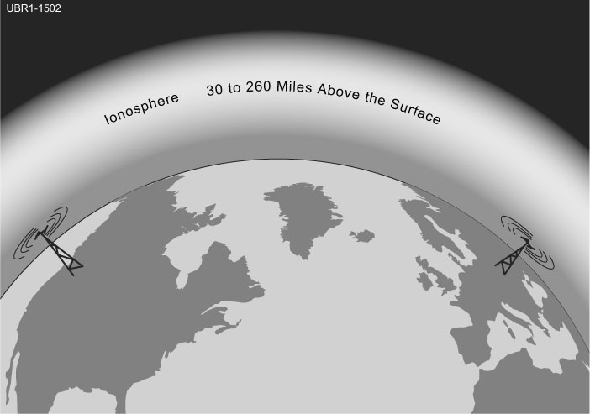
The Ionosphere
A region from 30 to 260 miles above the surface of the Earth
Atmosphere thin enough for atoms to be ionized by solar ultraviolet radiation
Ions are electrically conductive
Notes:
You may have to tap into some old science lessons and vocabulary that the students haven’t thought about in years.
Define ions and explain how radiation can remove electrons from an atom, creating an ion.

Slide 10
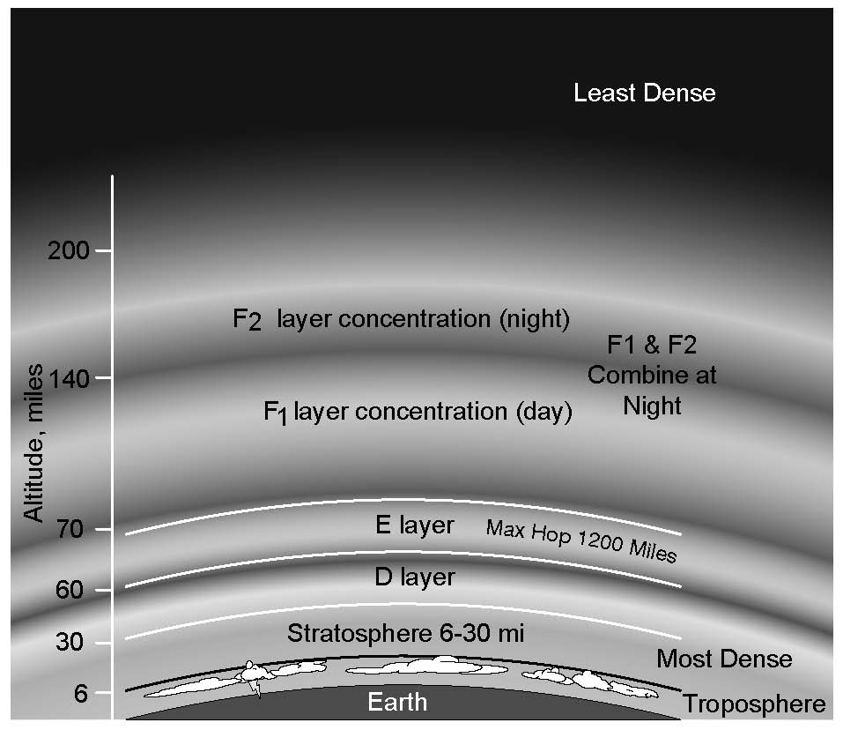
Ionospheric Levels
Because of varying density, the ionosphere forms layers with different amounts of ionization
Ionization varies with solar illumination (hour to hour) and intensity of solar radiation
Higher ionization refracts or bends radio waves more strongly
Notes:
The concept of temporarily stripping away the electrons is important. Discuss the time it takes for the ionization to dissipate during the evening and night time hours when sunlight is blocked.

Slide 11
Sunspot Cycle
The level of ionization depends on the intensity of radiation from the Sun.
Radiation from the Sun varies with the number of sunspots on the Sun’s surface.
High number of sunspots results in high levels of ionizing radiation emitted from the Sun.
Sunspot activity follows an 11-year cycle.
Notes:
Here is a good place to discuss the sunspot cycle, some of the students might make the connection between this practical application of science and the study of the Sun and to some things they have heard about sunspots and solar phenomena. Refer them to the spaceweather.com website.

Slide 12
The Ionosphere – An RF Mirror
The ionosphere can refract (bend) radio waves back to Earth – acts like reflection
Most refraction of amateur frequencies occurs in the F layer
Notes:
Explain how gradual refraction creates an apparent reflection. This is sky-wave or skip propagation.

Slide 13
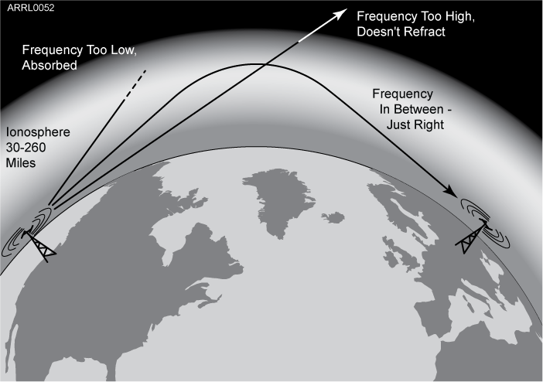
The Ionosphere – An RF Mirror
Reflection depends on frequency and angle of incidence.
Too high a frequency or angle and the waves are lost to space.
Notes:
If the angle is too steep, the waves go right through.
If the frequencies are too high, the refraction is insufficient to return the wave to Earth, creating a reflection or skip.
For low frequencies, signals can be absorbed by ionization in the lower layers (D and E), blocking propagation.
The varying amount of ionization through the day creates maximum and minimum usable frequencies for sky-wave propagation. (Explain MUF and LUF.) Hams interested in DX (you might have to explain DX) adjust their operating bands to take advantage of those frequencies that can be reflected by the ionosphere.

Slide 14
The Ionosphere – An RF Mirror
Sky-wave or skip propagation is responsible for most over-the-horizon propagation on HF and low VHF (10 and 6 meters) during peaks of the sunspot cycle.
Skip is very rare on the 144 MHz and higher UHF bands.
Each ground-to-sky-to-ground trip is called a hop.
Notes:
Explain the F-layer skip on 10 and 6 meters requires a very high MUF that usually occurs only during the peak years of the sunspot cycle.
The MUF rarely exceeds 70 MHz so sky-wave propagation from the F layer above 6 meters is also rare.

Slide 15
The Ionosphere – An RF Mirror
Signals can take many paths through the ionosphere.
Randomly combining at the receiving antenna, signals can partially cancel, creating irregular fading as the ionosphere changes.
The resulting echo and flutter distort speech and CW.
Fading causes data errors for digital signals.
Notes:
The ionosphere is constantly changing, so signals take many paths to arrive at the receive antenna. They can add together or subtract from each other, creating fading. The different lengths of the paths creates echo and flutter. (A recording of a polar path signal would be instructive.) This distortion is very hard on digital signals, creating a lot of errors.

Slide 16
Sporadic E (Es) and Aurora
Highly ionized patches of the E layer can reflect HF and VHF signals – best on 10, 6, and 2 meters.
Aurora near the north and south poles can also reflect VHF and UHF waves with a distinctive distorted sound.
Notes:
Explain that sporadic E “clouds” form in the E layer and if they are dense enough act to reflect signals back to Earth. Sporadic E propagation can occur at any time of the sunspot cycle.
Aurora is caused by charged particles flowing to the Earth’s surface. This creates a conductive vertical sheet that can reflect radio waves. The sheet’s surface is constantly moving, causing distortion to the signals it reflects.

Slide 17
Meteor Scatter
Thousands of meteors enter the Earth’s atmosphere every day – most quite small.
Meteors leave trails of highly ionized gas that last for several seconds.
Trails can reflect radio waves – called meteor scatter. The best band for this is 6 meters.
Mostly in the E layer, meteor scatter and sporadic E supports contacts up to about 1500 miles.
Notes:
Meteor scatter contacts are very short – a few seconds. Sophisticated software is used to exchange data during a single “ping” although sometimes an intense trail can support a quick voice contact lasting several seconds. Most meteor trails occur in the E layer so the communication distance is about the same as for sporadic E.

Slide 18
Practice Questions

Slide 19
What should you do if another operator reports that your station’s 2 meter signals were strong just a moment ago, but now they are weak or distorted?
A. Change the batteries in your radio to a different type
B. Turn on the CTCSS tone
C. Ask the other operator to adjust his squelch control
D. Try moving a few feet, as random reflections may be causing multi-path distortion
T3A01 HRLM (4-2)

Slide 20
What should you do if another operator reports that your station’s 2 meter signals were strong just a moment ago, but now they are weak or distorted?
A. Change the batteries in your radio to a different type
B. Turn on the CTCSS tone
C. Ask the other operator to adjust his squelch control
D. Try moving a few feet, as random reflections may be causing multi-path distortion
T3A01 HRLM (4-2)

Slide 21
Why are UHF signals often more effective from inside buildings than VHF signals?
A. VHF signals lose power faster over distance
B. The shorter wavelength allows them to more easily penetrate the structure of buildings
C. This is incorrect; VHF works better than UHF inside buildings
D. UHF antennas are more efficient than VHF antennas
T3A02 HRLM (4-2)

Slide 22
Why are UHF signals often more effective from inside buildings than VHF signals?
A. VHF signals lose power faster over distance
B. The shorter wavelength allows them to more easily penetrate the structure of buildings
C. This is incorrect; VHF works better than UHF inside buildings
D. UHF antennas are more efficient than VHF antennas
T3A02 HRLM (4-2)

Slide 23
What term is commonly used to describe the rapid fluttering sound sometimes heard from mobile stations that are moving while transmitting?
A. Flip-flopping
B. Picket fencing
C. Frequency shifting
D. Pulsing
T3A06 HRLM (4-2)

Slide 24
What term is commonly used to describe the rapid fluttering sound sometimes heard from mobile stations that are moving while transmitting?
A. Flip-flopping
B. Picket fencing
C. Frequency shifting
D. Pulsing
T3A06 HRLM (4-2)

Slide 25
Which of the following is a likely cause of irregular fading of signals received by ionospheric reflection?
A. Frequency shift due to Faraday rotation
B. Interference from thunderstorms
C. Random combining of signals arriving via different paths
D. Intermodulation distortion
T3A08 HRLM (4-2)

Slide 26
Which of the following is a likely cause of irregular fading of signals received by ionospheric reflection?
A. Frequency shift due to Faraday rotation
B. Interference from thunderstorms
C. Random combining of signals arriving via different paths
D. Intermodulation distortion
T3A08 HRLM (4-2)

Slide 27
What may occur if data signals propagate over multiple paths?
A. Transmission rates can be increased by a factor equal to the number of separate paths observed
B. Transmission rates must be decreased by a factor equal to the number of separate paths observed
C. No significant changes will occur if the signals are transmitting using FM
D. Error rates are likely to increase
T3A10 HRLM (4-2)

Slide 28
What may occur if data signals propagate over multiple paths?
A. Transmission rates can be increased by a factor equal to the number of separate paths observed
B. Transmission rates must be decreased by a factor equal to the number of separate paths observed
C. No significant changes will occur if the signals are transmitting using FM
D. Error rates are likely to increase
T3A10 HRLM (4-2)

Slide 29
Which part of the atmosphere enables the propagation of radio signals around the world?
A. The stratosphere
B. The troposphere
C. The ionosphere
D. The magnetosphere
T3A11 HRLM (4-3)

Slide 30
Which part of the atmosphere enables the propagation of radio signals around the world?
A. The stratosphere
B. The troposphere
C. The ionosphere
D. The magnetosphere
T3A11 HRLM (4-3)

Slide 31
Why are direct (not via a repeater) UHF signals rarely heard from stations outside your local coverage area?
A. They are too weak to go very far
B. FCC regulations prohibit them from going more than 50 miles
C. UHF signals are usually not reflected by the ionosphere
D. They collide with trees and shrubbery and fade out
T3C01 HRLM (4-3)

Slide 32
Why are direct (not via a repeater) UHF signals rarely heard from stations outside your local coverage area?
A. They are too weak to go very far
B. FCC regulations prohibit them from going more than 50 miles
C. UHF signals are usually not reflected by the ionosphere
D. They collide with trees and shrubbery and fade out
T3C01 HRLM (4-3)

Slide 33
Which of the following might be happening when VHF signals are being received from long distances?
A. Signals are being reflected from outer space
B. Signals are arriving by sub-surface ducting
C. Signals are being reflected by lightning storms in your area
D. Signals are being refracted from a sporadic E layer
T3C02 HRLM (4-4)

Slide 34
Which of the following might be happening when VHF signals are being received from long distances?
A. Signals are being reflected from outer space
B. Signals are arriving by sub-surface ducting
C. Signals are being reflected by lightning storms in your area
D. Signals are being refracted from a sporadic E layer
T3C02 HRLM (4-4)

Slide 35
What is a characteristic of VHF signals received via auroral reflection?
A. Signals from distances of 10,000 or more miles are common
B. The signals exhibit rapid fluctuations of strength and often sound distorted
C. These types of signals occur only during winter nighttime hours
D. These types of signals are generally strongest when your antenna is aimed west
T3C03 HRLM (4-4)

Slide 36
What is a characteristic of VHF signals received via auroral reflection?
A. Signals from distances of 10,000 or more miles are common
B. The signals exhibit rapid fluctuations of strength and often sound distorted
C. These types of signals occur only during winter nighttime hours
D. These types of signals are generally strongest when your antenna is aimed west
T3C03 HRLM (4-4)

Slide 37
Which of the following propagation types is most commonly associated with occasional strong over-the-horizon signals on the 10, 6, and 2 meter bands?
A. Backscatter
B. Sporadic E
C. D layer absorption
D. Gray-line propagation
T3C04 HRLM (4-4)

Slide 38
Which of the following propagation types is most commonly associated with occasional strong over-the-horizon signals on the 10, 6, and 2 meter bands?
A. Backscatter
B. Sporadic E
C. D layer absorption
D. Gray-line propagation
T3C04 HRLM (4-4)

Slide 39
Which of the following might cause radio signals to be heard despite obstructions between the transmitting and receiving stations?
A. Knife-edge propagation
B. Faraday rotation
C. Quantum tunneling
D. Doppler shift
T3C05 HRLM (4-1)

Slide 40
Which of the following might cause radio signals to be heard despite obstructions between the transmitting and receiving stations?
A. Knife-edge propagation
B. Faraday rotation
C. Quantum tunneling
D. Doppler shift
T3C05 HRLM (4-1)

Slide 41
What mode is responsible for allowing over-the-horizon VHF and UHF communications to ranges of approximately 300 miles on a regular basis?
A. Tropospheric scatter
B. D layer refraction
C. F2 layer refraction
D. Faraday rotation
T3C06 HRLM (4-2)

Slide 42
What mode is responsible for allowing over-the-horizon VHF and UHF communications to ranges of approximately 300 miles on a regular basis?
A. Tropospheric scatter
B. D layer refraction
C. F2 layer refraction
D. Faraday rotation
T3C06 HRLM (4-2)

Slide 43
What band is best suited for communicating via meteor scatter?
A. 10 meters
B. 6 meters
C. 2 meters
D. 70 cm
T3C07 HRLM (4-4)

Slide 44
What band is best suited for communicating via meteor scatter?
A. 10 meters
B. 6 meters
C. 2 meters
D. 70 cm
T3C07 HRLM (4-4)

Slide 45
What causes tropospheric ducting?
A. Discharges of lightning during electrical storms
B. Sunspots and solar flares
C. Updrafts from hurricanes and tornadoes
D. Temperature inversions in the atmosphere
T3C08 HRLM (4-2)

Slide 46
What causes tropospheric ducting?
A. Discharges of lightning during electrical storms
B. Sunspots and solar flares
C. Updrafts from hurricanes and tornadoes
D. Temperature inversions in the atmosphere
T3C08 HRLM (4-2)

Slide 47
What is generally the best time for long-distance 10 meter band propagation via the F layer?
A. From dawn to shortly after sunset during periods of high sunspot activity
B. From shortly after sunset to dawn during periods of high sunspot activity
C. From dawn to shortly after sunset during periods of low sunspot activity
D. From shortly after sunset to dawn during periods of low sunspot activity
T3C09 HRLM (4-4)

Slide 48
What is generally the best time for long-distance 10 meter band propagation via the F layer?
A. From dawn to shortly after sunset during periods of high sunspot activity
B. From shortly after sunset to dawn during periods of high sunspot activity
C. From dawn to shortly after sunset during periods of low sunspot activity
D. From shortly after sunset to dawn during periods of low sunspot activity
T3C09 HRLM (4-4)

Slide 49
What is the radio horizon?
A. The distance over which two stations can communicate by direct path
B. The distance from the ground to a horizontally mounted antenna
C. The farthest point you can see when standing at the base of your antenna tower
D. The shortest distance between two points on the Earth's surface
T3C10 HRLM (4-1)

Slide 50
What is the radio horizon?
A. The distance over which two stations can communicate by direct path
B. The distance from the ground to a horizontally mounted antenna
C. The farthest point you can see when standing at the base of your antenna tower
D. The shortest distance between two points on the Earth's surface
T3C10 HRLM (4-1)

Slide 51
Why do VHF and UHF radio signals usually travel somewhat farther than the visual line of sight distance between two stations?
A. Radio signals move somewhat faster than the speed of light
B. Radio waves are not blocked by dust particles
C. The Earth seems less curved to radio waves than to light
D. Radio waves are blocked by dust particles
T3C11 HRLM (4-1)

Slide 52
Why do VHF and UHF radio signals usually travel somewhat farther than the visual line of sight distance between two stations?
A. Radio signals move somewhat faster than the speed of light
B. Radio waves are not blocked by dust particles
C. The Earth seems less curved to radio waves than to light
D. Radio waves are blocked by dust particles
T3C11 HRLM (4-1)

Slide 53
Which of the following bands may provide long distance communications during the peak of the sunspot cycle?
A. Six or ten meters
B. 23 centimeters
C. 70 centimeters or 1.25 meters
D. All of these choices are correct
T3C12 HRLM (4-4)

Slide 54
Which of the following bands may provide long distance communications during the peak of the sunspot cycle?
A. Six or ten meters
B. 23 centimeters
C. 70 centimeters or 1.25 meters
D. All of these choices are correct
T3C12 HRLM (4-4)

